Slide 1
NAYA - Project 4
Bank Customer Churn Prediction Model
Olga Soudler, Manor Shpriz
Nov 2024

Slide 2

Overview
Objective: Predict customer churn to aid retention strategies by identifying high-risk clients.
Problem Statement: Customer churn impacts profitability; predicting and mitigating churn is essential.
Data Overview: Includes demographics, financial status, account activity, and churn data.
Tools & Libraries: pandas, scikit-learn, Optuna.

Slide 3

Methodology & Population
Data set contains 10,000 customers
Churn percentage is 20.37%
Training/Test sizes used – 80%/20%
Data Variables: 6 numeric 2 categorical 2 binary
Testing 6 models: Logistic Regression, K-Nearest Neighbors, Support Vector, Decision Tree, Random Forest and Gradient Boosting algorithms
Gradient Boosting model showed better results, in accordance with the objectives.
Generating predictions based on the XGB model

Slide 4
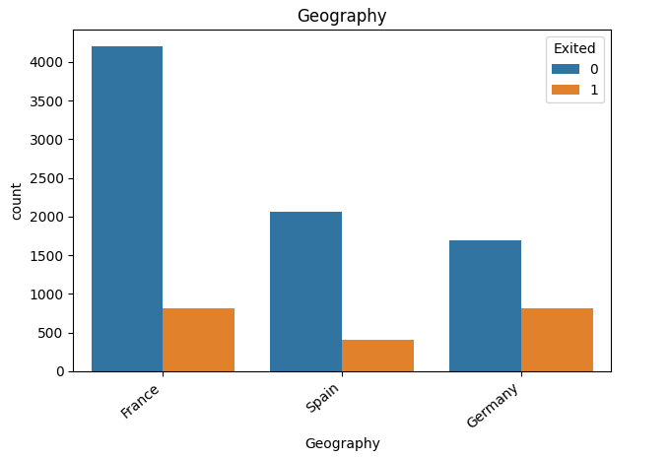
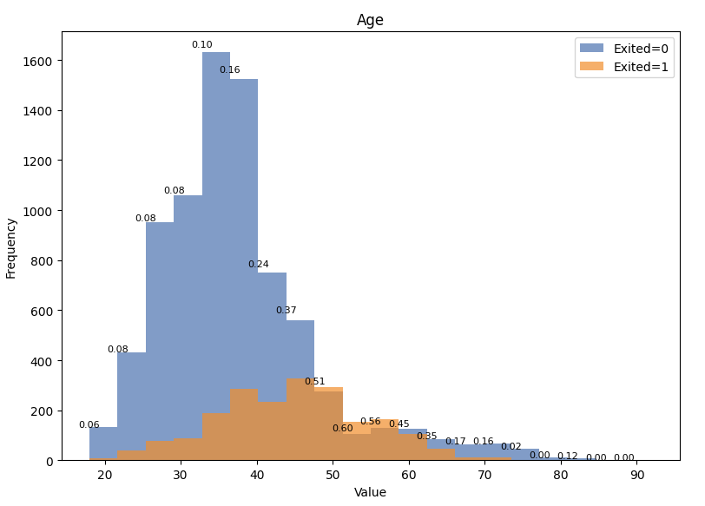
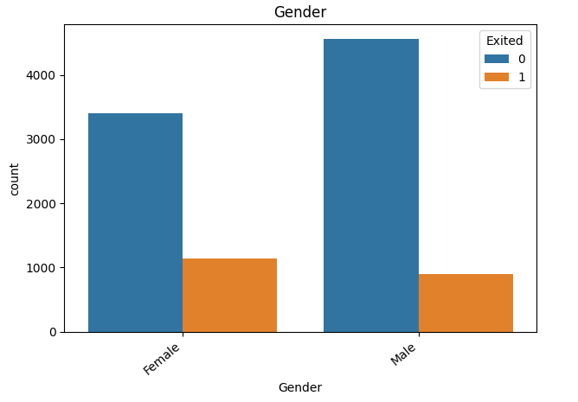
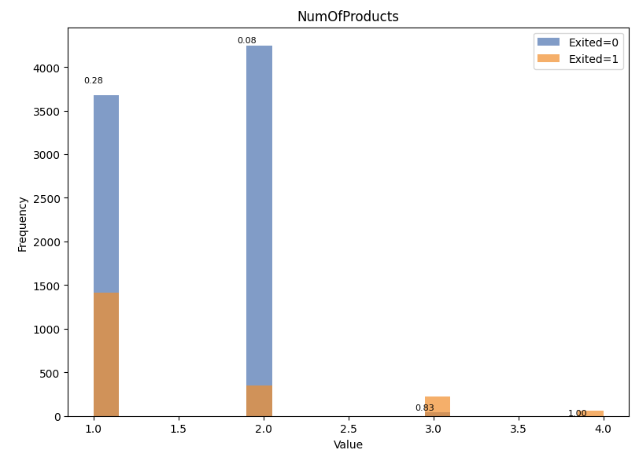
Model - EDA
No unexplainable outliers were present.
No evident interrelationship among the numerical variables.
Product Count: Customers with three or more products exhibit a significantly higher churn rate. Excluding this group could be considered during the modeling process.
Geography: German customers show a distinct churn pattern compared to those from France and Spain.
Gender: Female customers have a higher churn rate than male customers.
Active Membership: Active members tend to have a lower churn rate.
Balance: Accounts with a balance of zero behave differently than those with a positive balance, potentially warranting a separate categorical consideration.
Credit Score: Lower credit scores may correlate with increased churn risk.
Age: Churn rates appear notably higher among customers aged 40 to 60.

Slide 5
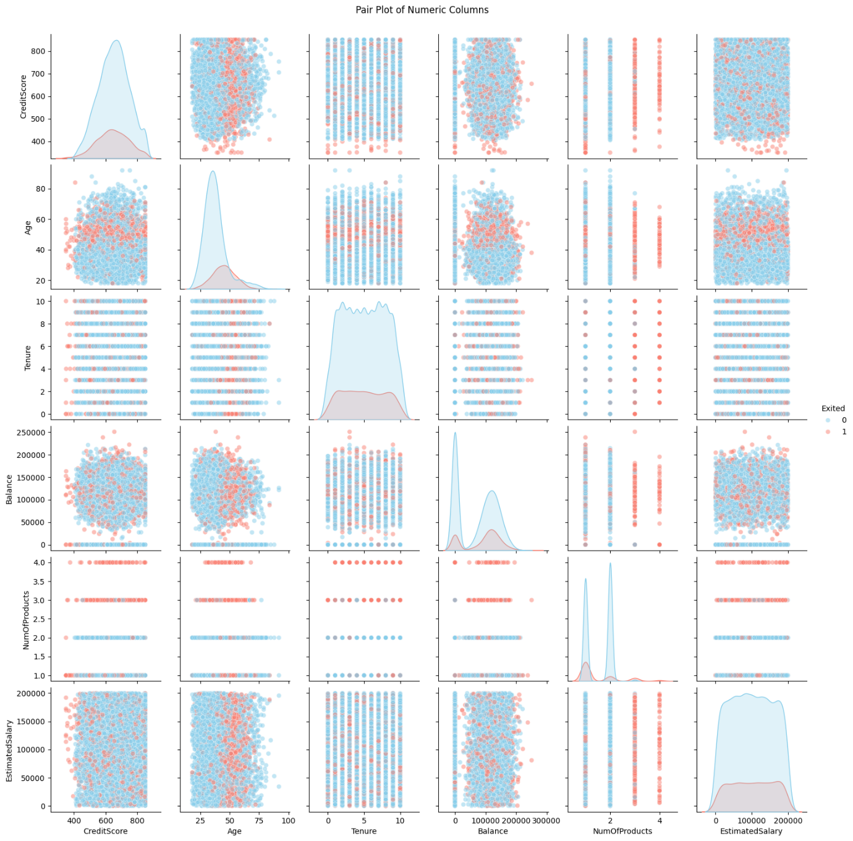
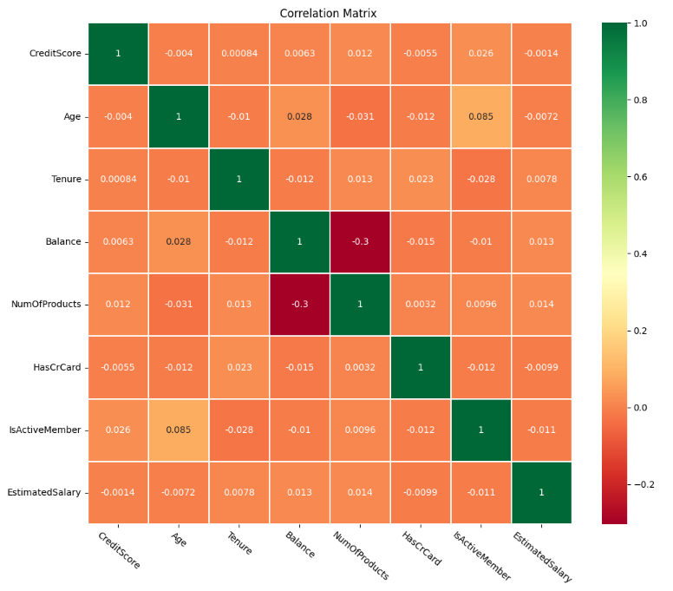
Model - EDA

Slide 6
Modeling Objectives
To build an effective churn prediction model, the primary focus will be on recall and precision to ensure that the model captures as many potential churners as possible while minimizing false positives:
Therfore, metric Priorities for Bank Churn Prediction should be prioritized as follows:
Recall: Prioritize high recall to ensure most potential churners are identified.
Precision: Maintain high precision to reduce unnecessary intervention costs on customers who are not at risk.
F1 Score: F1 score as a balanced metric to assess the overall performance between recall and precision.
Accuracy: Not a primary focus due to data imbalance. To be tracked only to provide an overall performance picture.

Slide 7
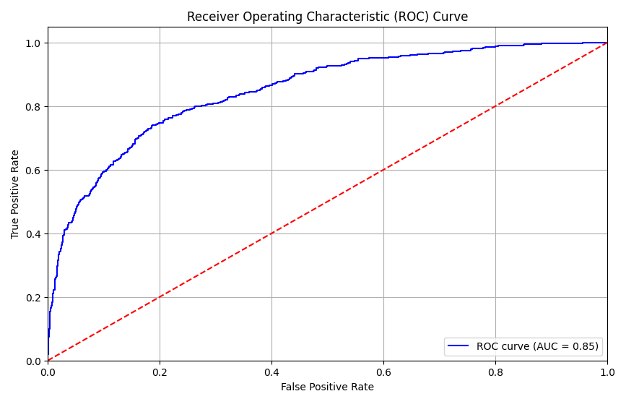

Model - Results – Evaluation Metrics
The selected model is an ensemble model of XGB and RF. It has the best recall ratio achieved, as well as a high f1 score, which are in accordance with the objectives. Regarding precision, moderate precision score means that about 46% of people who would be treated as potential churn are probably loyal customers, which is a price to be considered by the bank CRM team, while making the assessment against the benefits of missing the minimal number of churners.
Classification Report

Slide 8

Next Steps
1
Building Churn protocol to retain customers who are likely to churn.
2
Testing and Monitoring the results closely.
3
Making Improvements and changes in the model as needed, as more data accumulates.
4
Testing more advanced models.

Slide 9
Thank you ☺

